Slide 1


Titolo presentazione sottotitolo
Musical Tree
Milano, XX mese 20XX
Creative Programing And Computing a.y. 2020/2021
Gioele Greco 943518, Tommaso Botti 944537, Nicolò Botti 944540
Notes:
GIOELE

Slide 2

Abstract
The Musical Tree is a 3D music visualizer that can adapt itself depending on the musical genre to which it is exposed.
The main components are:
a tree that grows “following” the music, which represents the history of the perception
other interactive elements
which react to the current changes
The main purpose is to use this application in live concert or installations, in order to make some musical features visible.
For example to be a projection or hologram in the hall.

Slide 3
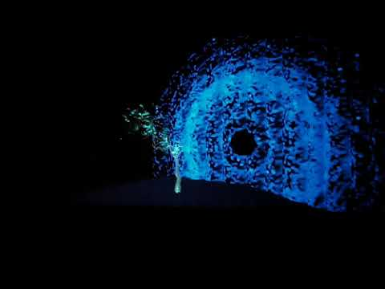

Slide 4


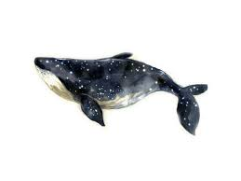
Motivations
Develop methods to bring the public closer to music. It was chosen to support listening with video, so that every sound, shape and musical symbol is graphically represented in real time.

Slide 5
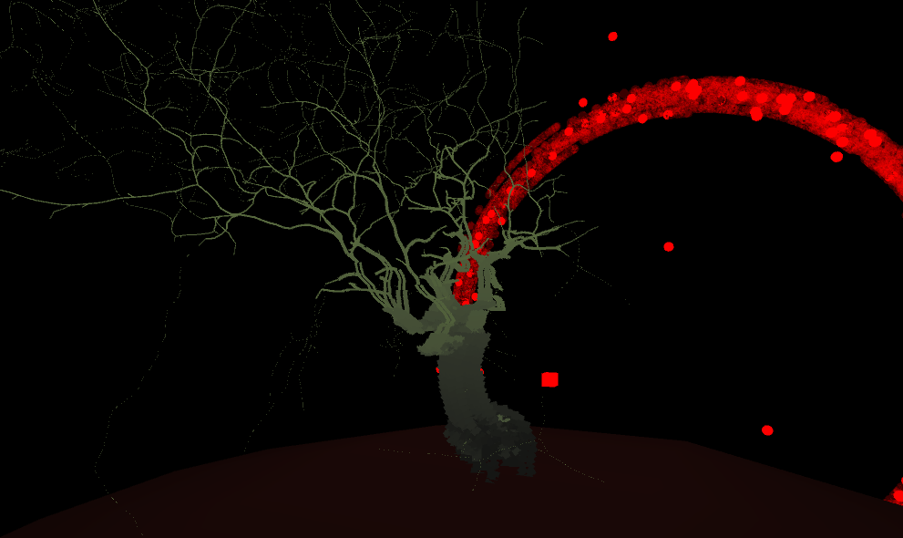
Aesthetic choices : Tree - environment
Tree, human and living things have different time perception.
This concept was investigated by Gerard Grisey that correlated bugs high time perception to whales low time perception.
In our case the time is adapted to the human time perception, which makes the tree grow in a way that is perceptible to a man in a short time.
The environment contains some interactive elements that change between each musical genre.

Slide 6
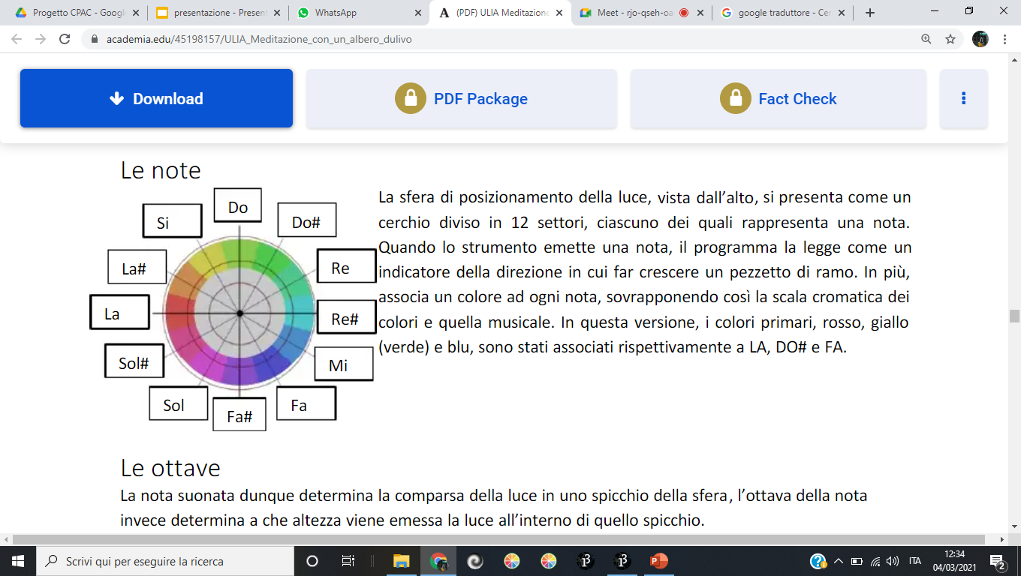
Aesthethic choices: Colors and Light
Colors and sounds are associated by the superposition of the color chromatic wheel and the music chromatic wheel.
The light intensity is associated to the intensity of the sound.
This synaesthetics choices are very common in classical music since the 700’.

Slide 7

General description

Slide 8
General description
The application consists in a 3D world composed by a planet with a growing tree on its surface.
Different visualizations are showed depending on the musical genre that is played, which is determined by the application itself.
Each visualization interacts with the music that is played depending on different musical parameters.

Slide 9

Adopted methodological solutions

Slide 10
Adopted methodological solutions
Musical genre classification is implemented in Python through a Machine Learning based algorithm.
The different visualizations are realized in Processing.
The communication between Python and Processing is realized via OSC messages.
Group 15
Notes:
GIOELE
features, related with rhythm, spectral and tonal characteristics of music. We consider the features to be integrated over the whole duration of the audio segment by means of the central statistical moments up to the 4th order. Support Vector Machine technique is then used to perform the classification task.

Slide 11

Technical details
Python implementation
Processing implementation

Slide 12

Python implementation
We started from the GTZAN dataset which is a database of 1000 music pieces of ten different genres: Blues, Classical, Country, Disco, Hiphop, Jazz, Metal, Pop, Reggae, Rock.
We chose to implement a classifier able to discriminate only between Classical, Pop, Reggae, Rock and Jazz.
The algorithm is structured
in two main sections:
Audio Features extraction process
Support Vector Machine classifier
Group 15
Notes:
GIOELE
features, related with rhythm, spectral and tonal characteristics of music. We consider the features to be integrated over the whole duration of the audio segment by means of the central statistical moments up to the 4th order. Support Vector Machine technique is then used to perform the classification task.

Slide 13
Feature Extraction
To construct a “robust” music genre classifier, it is crucial to extract features that allow direct access to the relevant genre-specific information:
“Low-Level” audio features:
extracted from critically sampled windows of 1024 samples length (44.5ms), overlapping factor is 50%
“High-Level” audio features:
extracted from longer critically sampled windows of 4096 samples length (186ms), overlapping is 75%
Features can be grouped into three main categories:
Rhythmic
Spectral
Tonal
Group 15

Slide 14
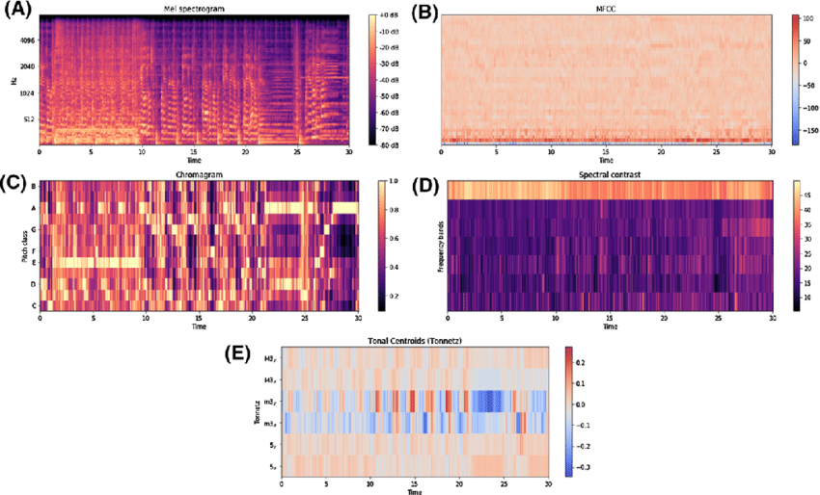
Extracted features
High-Level features
Tonal features:
- Chromagram
- Tonal Centroid
- HCDF
Low-Level features
Rhythmic features:
- Tempo
Spectral features:
- Spectral Centroid
- Spectral Roll-Off
- Spectral Flux
- RMS Energy
- Zero Crossing Rate
- Spectral Bandwidth
- Spectral Flatness
- Spectral Contrast
- MFCCs (13)
Notes:
(Harmonic Change Detection Function)
A – Spectrogram
B – MFCCs
C –chromagram
D- spectral centroid
E- tonal centroid

Slide 15
Statistical moments
The different frame-based features are integrated by means of different statistical values:
Low order moments:
Maximum,
Minimum,
Mean,
Standard Deviation.
High order moments:
Skewness
Kurtosis
High order moments are used to increase the classification accuracy providing all the possible supplementary statistical information for the audio signal

Slide 16
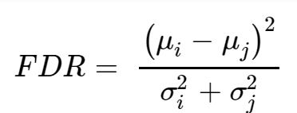
Feature Analysis and Visualization:
We refer to the definition of the Fisher Discriminant Ratio as a metric to evaluate the discrimination power of each single feature in separating the different classes.
This definition is applied to each single feature for each possible couple of classes that need to be discriminated.
Notes:
MARTINO
Where μi,j
are respectively the means of one specific feature for each of the two classes under analysis and σi,j
are the variances.

Slide 17
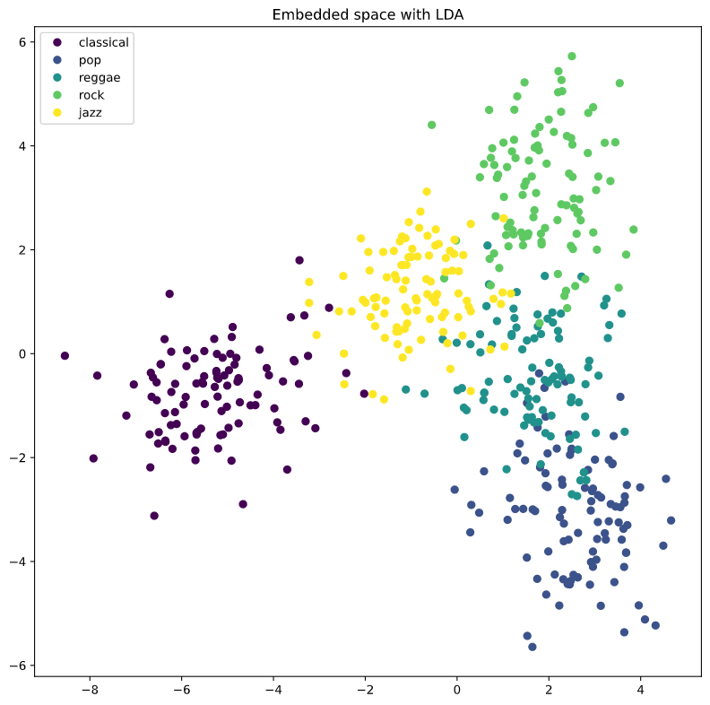
LDA algorithm
To aid visualization of the structure of the dataset, the dimension must be reduced.
The LDA algorithm (Linear Discriminant Analysis) can be used for this purpose (optimization of the Fisher Discriminant Ratio)
Notes:
MARTINO

Slide 18
Support Vector Machine Classification
To proceed, we split the features space into training set and test set.
The splitting proportion is:
- 25% testing
- 75% training
The learning procedure is built in a structured way so that different SVM classification models are evaluated in performance.
The model is then used to predict samples within the Test set.
The training data will be used for learning and for model evaluation through the process of cross-validation.
Notes:
OLIVIERO

Slide 19
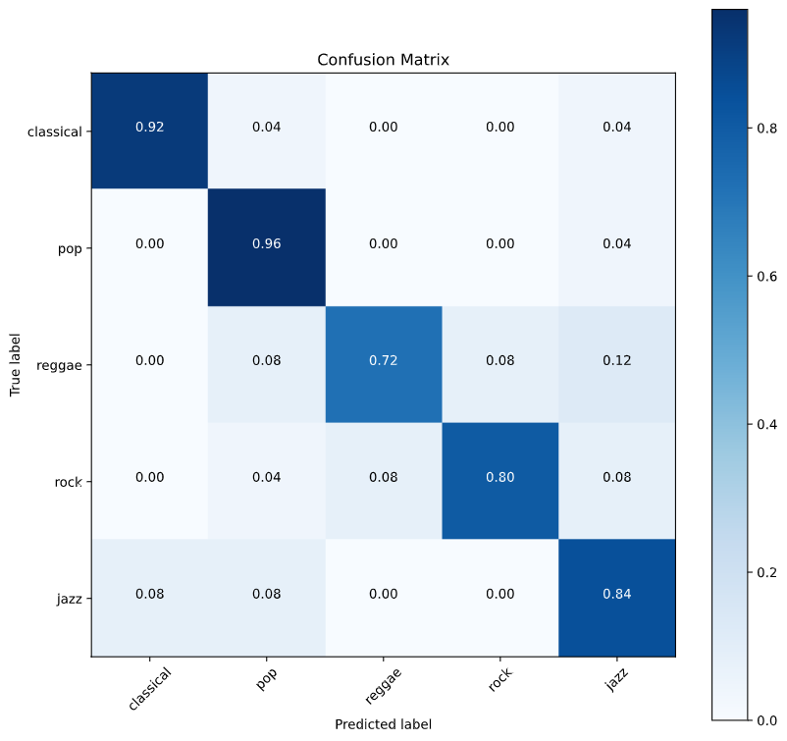
Confusion matrix plot
Notes:
TOMMASO

Slide 20
Dynamic classification
We implemented an algorithm which performs a recording of 1s each time the user presses the ‘r’ key.
The recording is then fed to the model that extracts the features from it and determines its genre.
Finally the labelled genre is sent to Processing via OSC messages, together with the beat of the musical piece.

Slide 21

Processing implementation
The implementation can be divided in three parts:
elaboration of the audio input
graphical components:
tree
environment
musical genre components
communication from Python
to Processing

Slide 22
Processing implementation: Audio
We started from the “Audio analysis for pitch extraction” made by L. Anton-Canalis that uses Minim library.
This code was rearranged to our purposes and extracts some parameters like:
Spectrum
first 10 high intensity harmonics (frequency and amplitude)
total amplitude of the signal

Slide 23
Processing implementation: Audio
Energy of the signal Each one of these parameters is also stored in a buffer that allow to calculate:
mean intensity level
mean spectrum
By the way the amplification is automatically adjusted, when there is some peaks it goes down, when there is a constantly low intensity, it rise the volume.
General commands: UP/DOWN : amplificate +0.1 or -0.1 the audio

Slide 24
Graphical component
The graphical component can be classified in two time-dependent macro classes:
stored data component: tree
instantaneous reactive components

Slide 25
Processing Graphical components: Tree
Tree grows through points that are calculated and stored every 0,8s during all the time of the application life.
Its location is determined from attraction points that are computed starting from the audio datas.
A branch grows from the minimum distance between the existing branches and the attraction point.
There are also some condition that decide where put new branches points, like mass equilibrium condition.
To each young and light branch can grow a leaf, normally to its direction, that is made by Bezier curves.

Slide 26
Tree: points calculation
Attraction point location is determined in polar coordinates:
The sphere in which the tree grows, view from top, appears as a notch divided into 12 sectors, each of which represents a note.

Slide 27
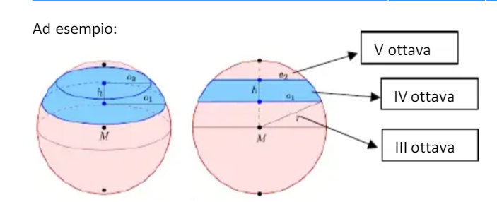
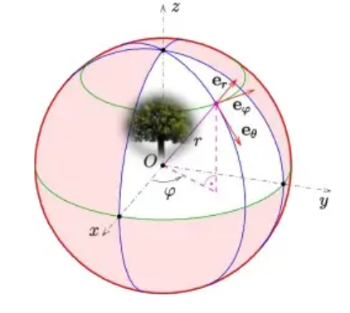
Processing Graphical components: Tree
The height of the sound is correlated to the height of the light-point.
The distance from the sphere center is related to the sound intensity
Every harmonic component position is weighted and the resulting position is the attraction point of the tree

Slide 28
Processing Graphical components: Tree
Every branch has a weight, that grows in time, used to evaluate the growing position considering the mass equilibrium around the center of gravity of the tree.
The tree grows down after 10s of silence, and can grow up instantaneously in the best way to reach the previous position
If there are some branches on the ground they can create other trees

Slide 29
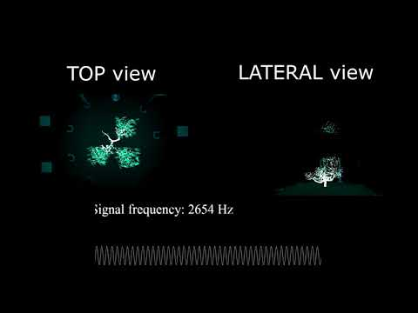

Slide 30
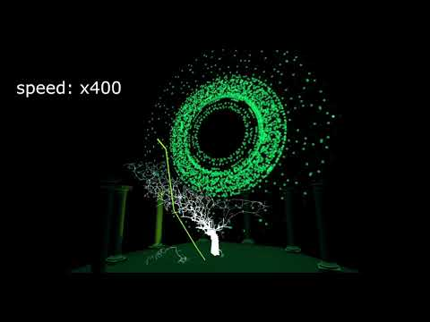

Slide 31
Processing Graphical components: Environment
The environment is made of a sphere, that is the planet on which the tree grows.
At a distance Z over the planet is located a light that has the color of the sum of the sounds colors. Its intensity depends from the sound intensity.
A bolt starts from the light computed point and falls on the planet when the sound level is around the peak. Its color is related to the highest sound.

Slide 32
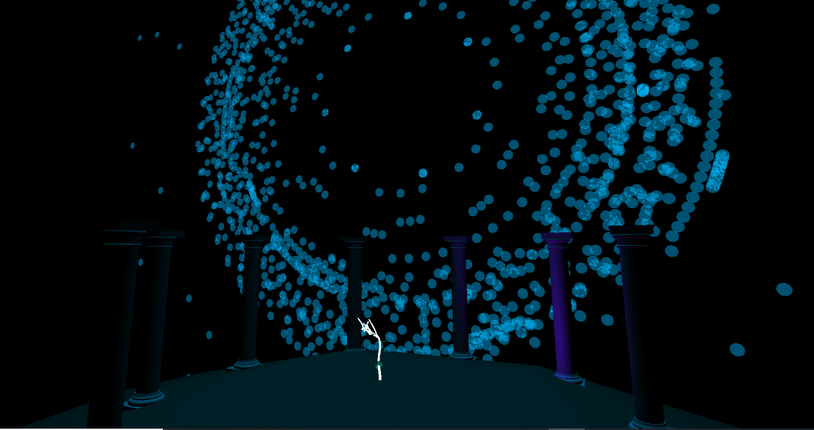
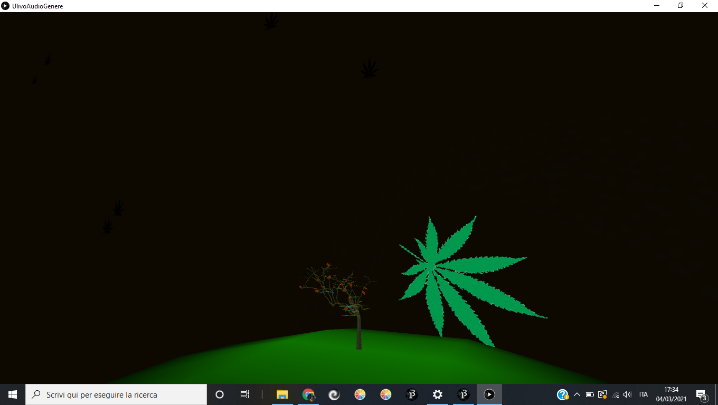
Processing Graphical components:
Musical genre components
CLASSICA | 7 columns around the tree that represents the notes. They shake when the level is around the peak a light illuminates the column of the highest note proportionally to the intensity of sound sun that is computed like waveshape in 2 dimensions
REGGAE | setting sun that is computed like waveshape in 2 dimensions “typical” leaves that navigate in the sky background and tree leaves are colored in green, yellow and red

Slide 33
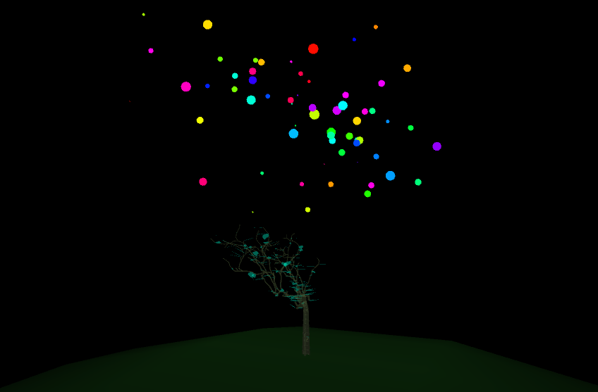

Processing Graphical components:
Musical genre components
POP | Flash when level is very high Color mixed points cloud that expands proportionally to the sound level
ROCK | Flash with rock hands on the background planet that change radius as sound level

Slide 34
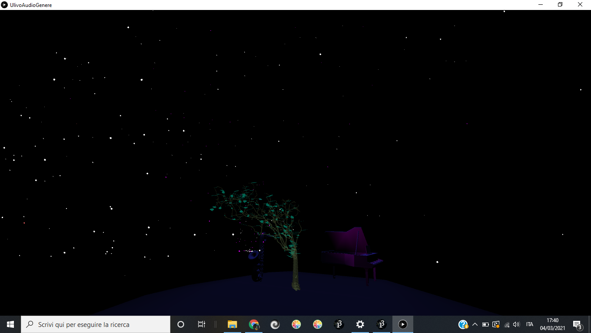
Processing Graphical components:
Musical genre components
JAZZ | Stars that moves simulating a real sky saxophone and piano that moves as the sound level star fountain that come out from the sax when mean level is high light in piano of the color of the strongest note

Slide 35


